Slide 1
Critical Thinking and Politics
Dr. Matthew Hall
Week Ten: The Media

Slide 2
Hard v soft versions of theories
Hard versions of theories are potentially more useful but soft versions are often more applicable.
Ex: critical theory

Slide 3
The Media in one interactive chart
Reminder: journalism is very much a type of expertise
https://adfontesmedia.com/interactive-media-bias-chart/
What about in other countries?
The UK?
Canada? Mexico? Sweden?
Iran, China and Russia?
What do academics say? https://scholar.google.com/
What to make of the lawsuits against FOX News?
https://thehill.com/homenews/media/3962900-what-fox-news-dominion-settlement-means-for-its-next-major-legal-fight/

Slide 4
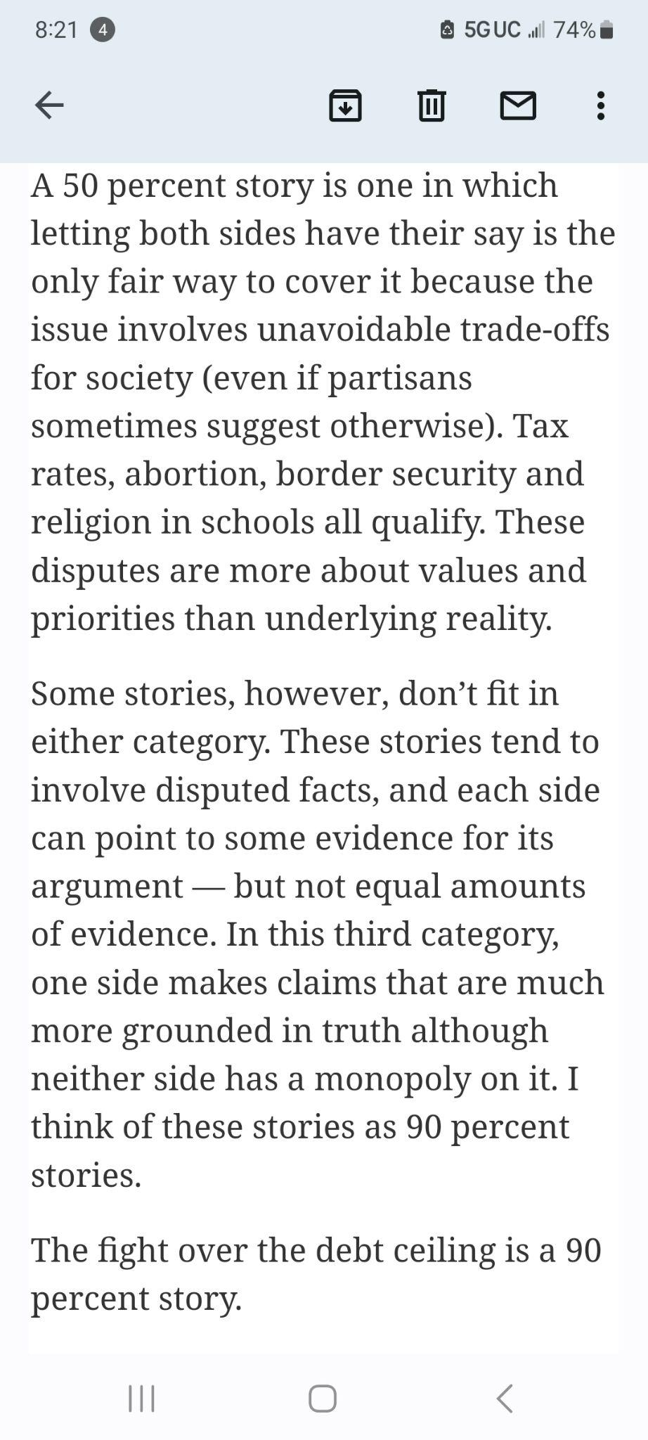
From the NYT

Slide 5
Horizontal v Vertical information flow
Traditionally, information flows vertically, top-down
Political attitudes: the conservatism of ‘Obey your elders’ and ‘children are to be seen and not heard’
In the digital era, information flows horizontally as much as vertically. It also flows ‘bottom-up’

Slide 6
What counts as media?
What are we to make of:
Blogs
Tiktok
Twitter
Reddit
Wikipedia
The Daily Show

